Slide 1
Energy Smart Communities Initiative
The New Knowledge Sharing Platform
Presented to the APEC-ISGAN Smart Grid Test Bed Networks Workshop
January 25, 2012 8:30 am
Dr. Eugenie Birch, Co-Director Penn IUR
Alon Abramson, PM Penn IUR

Slide 2
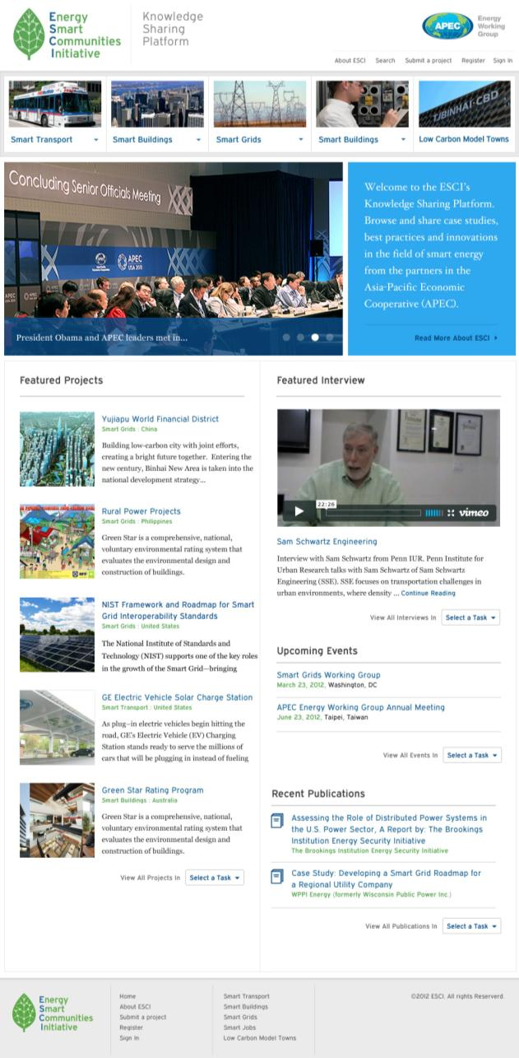
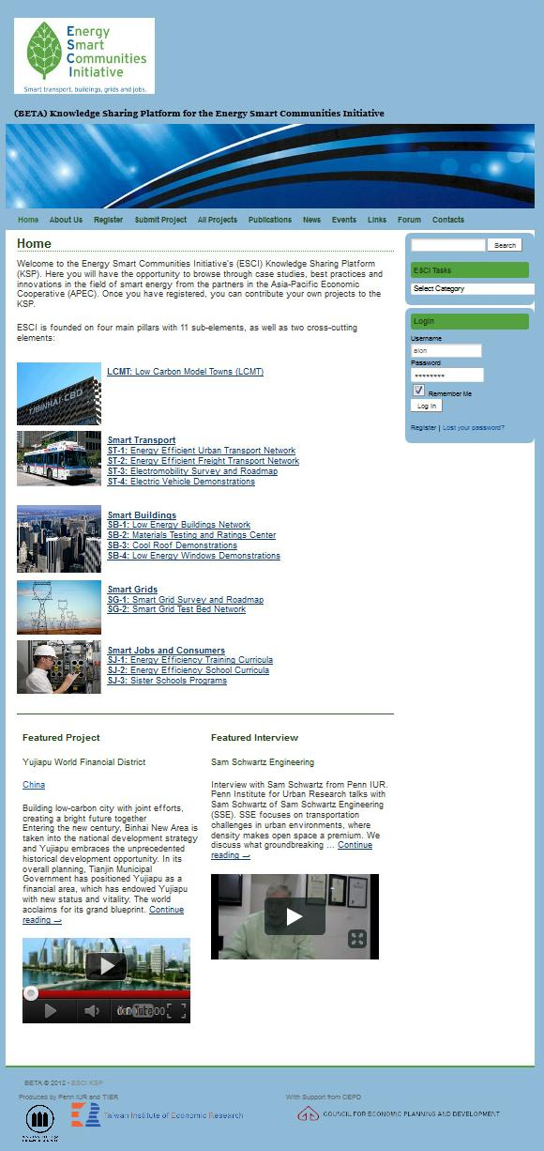
The Home Page
Simplified navigation
Slideshow informs users of recent events and news and ties in APEC.org brand recognition
Featured content ties together all ESCI pillars. Gives visitors ‘snapshot’ of what ESCI is all about
Beta
Site
New Site
Upcoming events & recent publications on Home page

Slide 3
New Header Navigation
APEC EWG Logo Added
Main site navigation elements built into header
Pillar and task navigation built into header

Slide 4
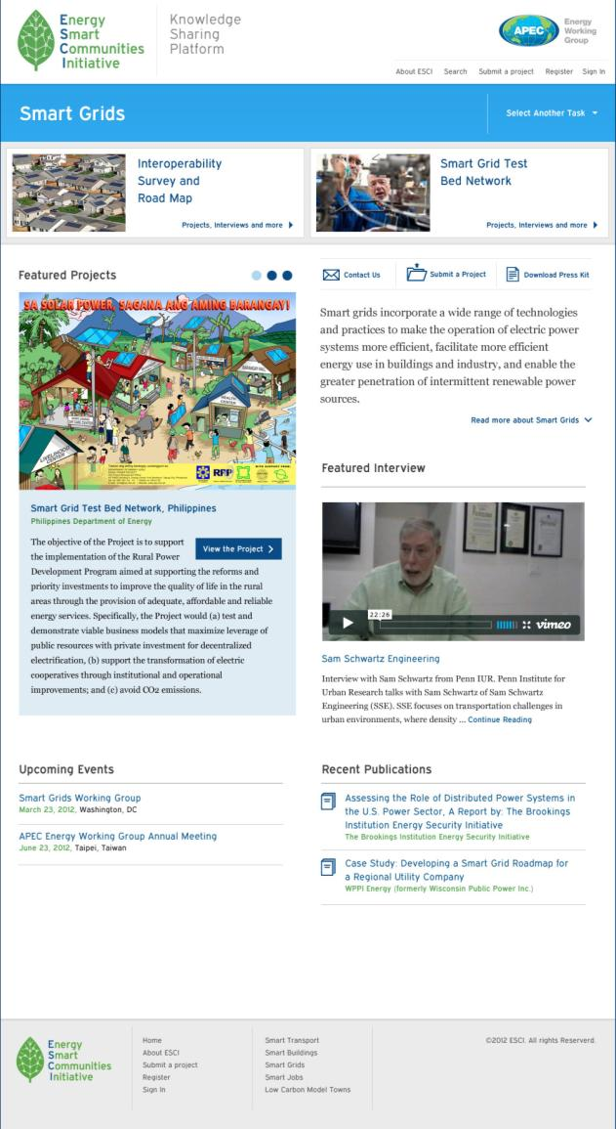
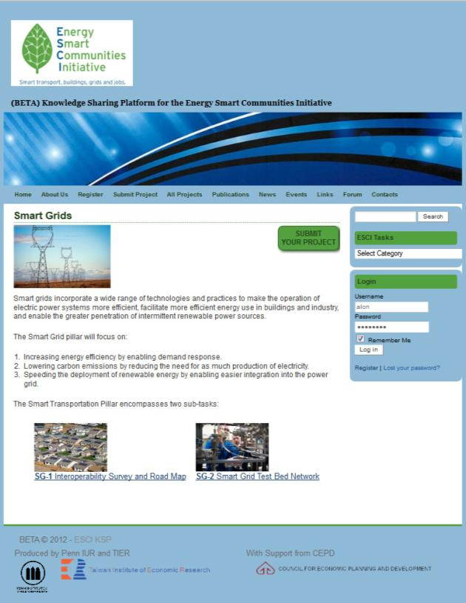
Easily navigate to any other pillar and task
Smart Grids Pillar Page
Task navigation is now front and center
Icons make user navigation simple
Featured content specific to each Pillar
Events and Publications specific to each Pillar

Slide 5
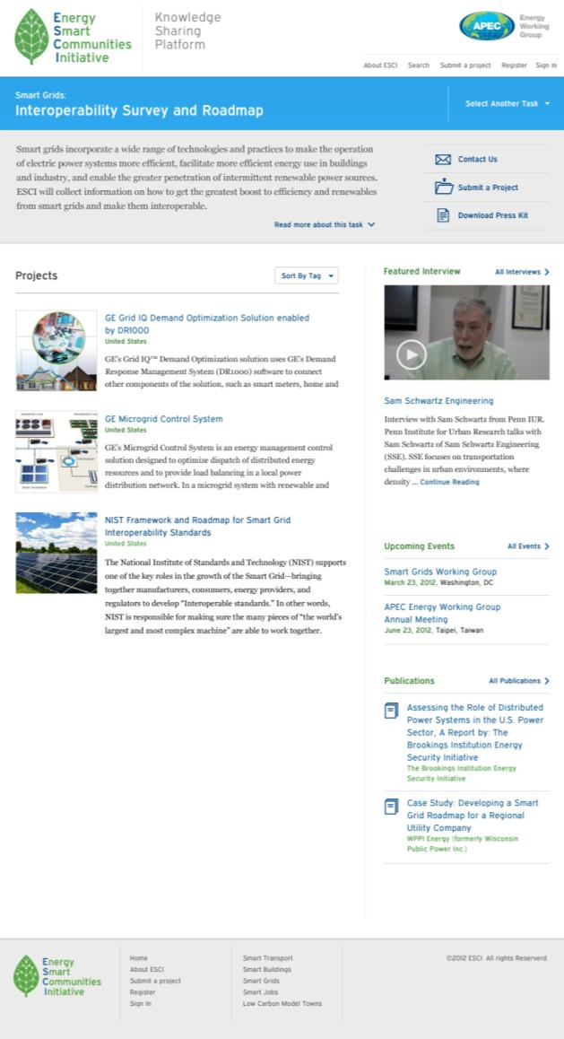
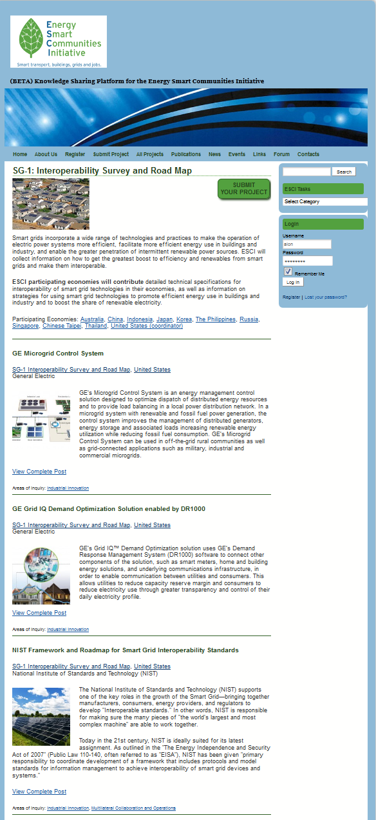
SG-1 Sub-Task Page
‘Sort by’ allows filtering by tag, economy and date
Interview, events and publications specific to the sub-task
Full project listing for each sub-task

Slide 6
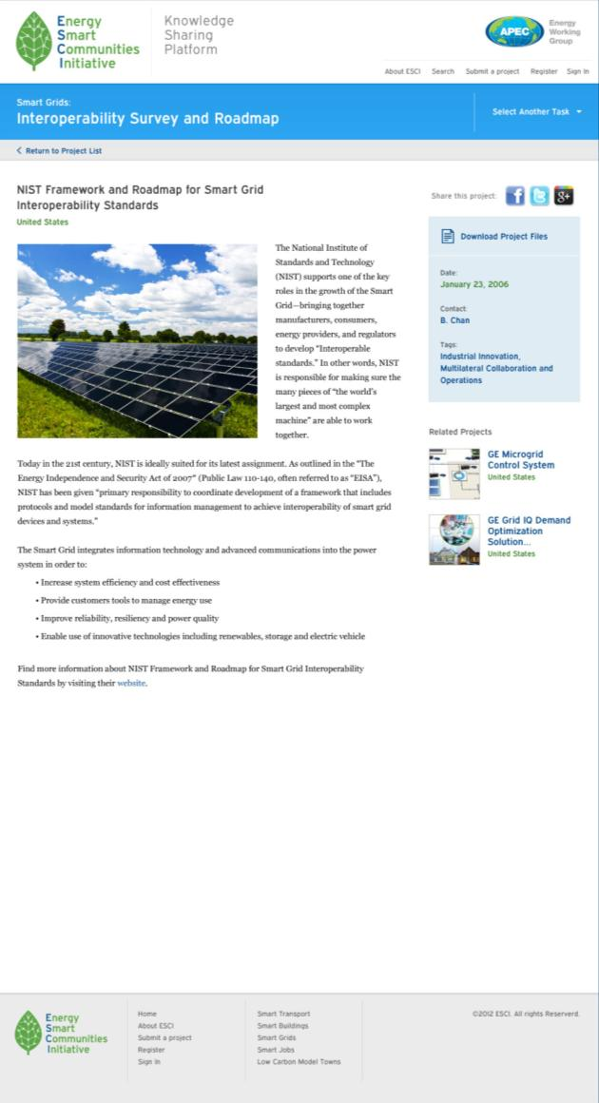
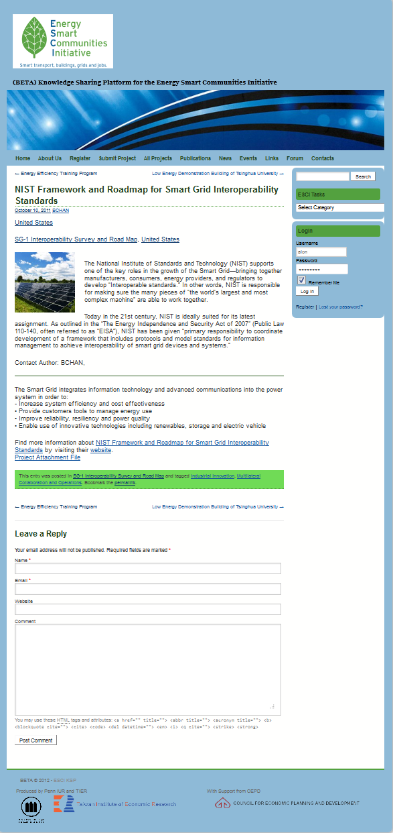
Social networking links
Example Project Page
Concise project data
Related projects links

Slide 7
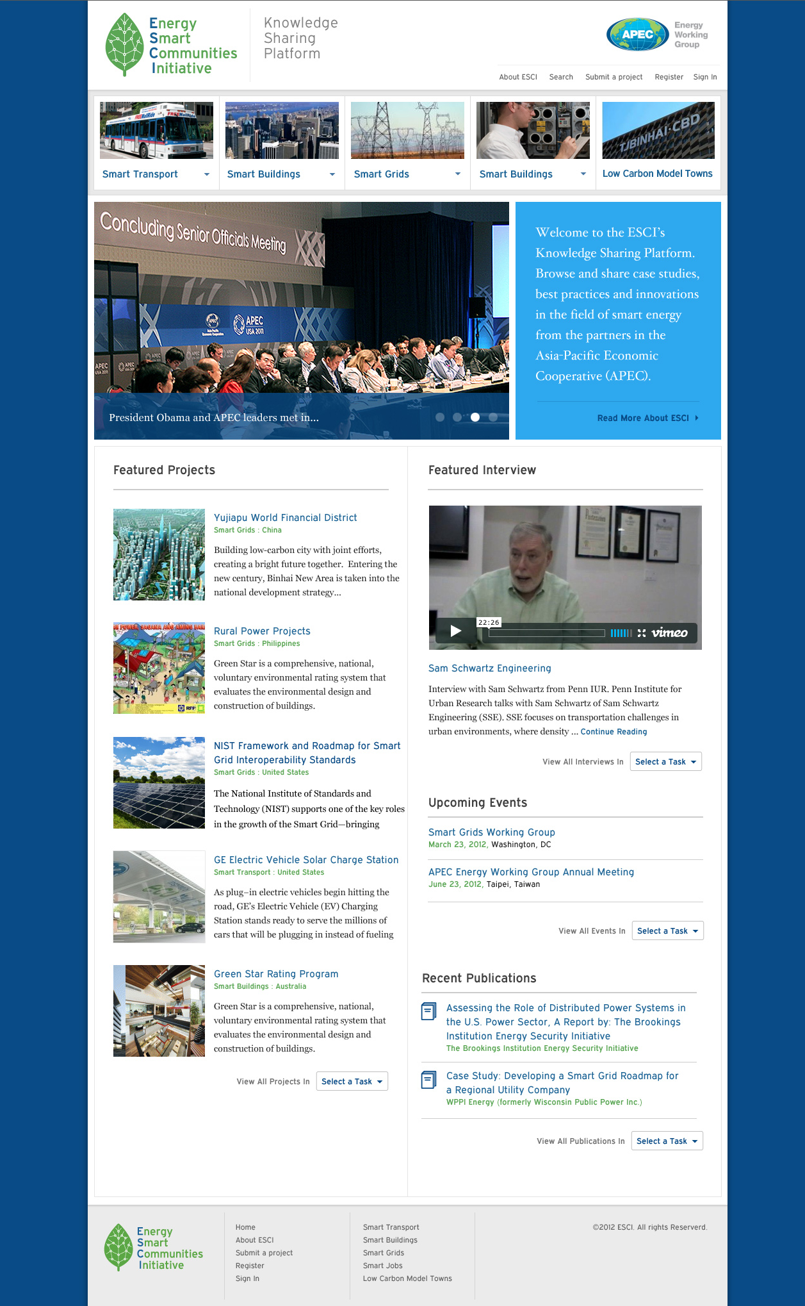
new

Slide 8
Thank You.
Contact Us:
Dr. Eugenie Birch
Co-Director, Penn Institute for Urban Research
elbirch@upenn.edu
Alon Abramson
Project Manager, Penn IUR
alonabra@upenn.edu
Website: http://esci-ksp.org

