Slide 1


Network Excellence
for Smarter Grids
European Distributed Energy Resources Laboratories e.V.
- overview -
Diana Craciun
DERlab e.V.
Research Coordinator
APEC ISGAN Workshop, Washington DC, 24/Jan/2012

Slide 2
Background
Increasing share of RES and DER in power systems
Structural change in electricity grids → Smart Grids
  Distribution grids contribute to the system operation (stability, energy management, safety)
  Consistent integration of ICT controlling of DER
Urgent need for applied research in appropriate infrastructures
  DER-units have to provide PSS
  Urgent need for new control strategies and interfaces
  Urgent need for testing procedures definition
2
Notes:
e.g. Germany

Slide 3
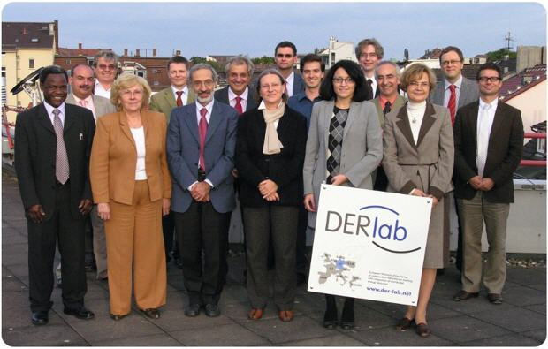
History
2005
  11 European research institutes collaborate in the “European Network of Excellence of DER Laboratories and Pre-Standardization” funded by EC
2008
  Project Consortium founded DERlab e.V. as legal entity
  Non-for-profit association
3
Notes:
e.g. Germany

Slide 4
DERlab is a network
of 21 institutes for Distributed Energy Resources (DER) and Smart Grids
performing accredited testing of DER-units and systems
supporting Smart Grids development
organising information exchange on test facilities and DER knowledge
contributing to standardisation
4

Slide 5
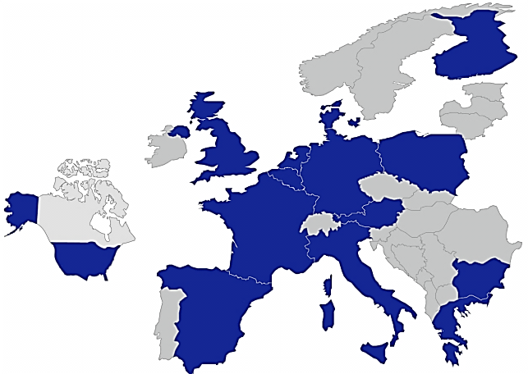

















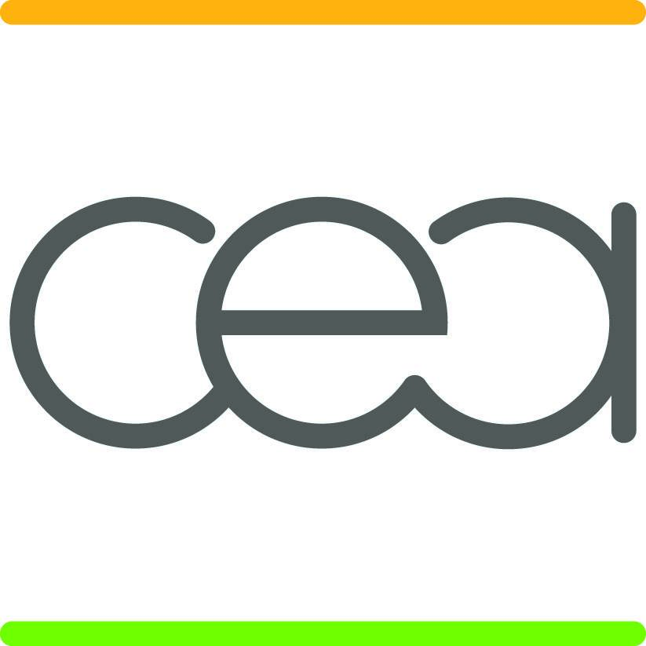



European Distributed Energy resources Laboratories e.V.
Network Excellence for Smarter Grids
5

Slide 6




Member services
Visibility
Joint research
Information
Networking
Company profile
Description of facilities, services, expertise
Vacancies portal
Activities portal
Support and coordiantion of common research
Coordination of knowledge transfer
List of conferences and events
Standardisation activities
Research opportunities
Database of information material
Internal workshops and events
Interfacing contact to industry, other research institutes
6

Slide 7


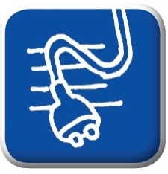
External services
Testing
Technical support
Information Platforms
DER Individual components
Full systems
Protection devices
...according to standards and grid codes
Technical workshops
Training courses
Consulting on interconnection requirements and standards
Database of European Interconnection Specifications
DERlab Infrastructures Database
7

Slide 8

Test beds access
Distributed Energy Resources Research Infrastructure
Objectives
  offering access opportunities to European RI in DER field
  performing R&D on DER interfaces and architectural system aspects
Means to infrastructures access
  facilities managed according to specific protocols
    Common evaluation criteria
    Facility Usage Guidelines
    User Rights and Responsibilities
    Laboratory Staff Rights and Responsibilities
    Proper Use Regulations
    Terms of Stay
    Lab Use Agreement
    …
www.der-ri.net
8

Slide 9

Test beds access
Photovoltaic European Research Infrastructures:
Objectives
  offering access opportunities to European RI in PV field
  performing R&D on PV technologies
Means to infrastructures access
  facilities managed according to specific criteria
    General criteria for laboratory work and equipment management
    Transnational user access procedures
      Common evaluation criteria
      Financial conditions for accessing
      Processes for logistic management
      Processes for cost management
    …
www.sophia-ri.eu
9

Slide 10
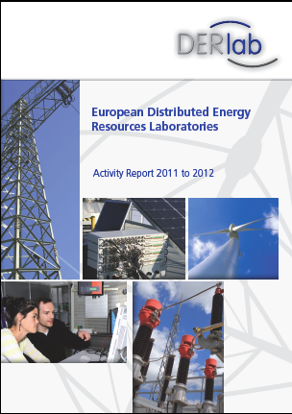
Contact us:
European Distributed Energy Resources Laboratories (DERlab) e.V.
c/o Fraunhofer IWES
Königstor 59
34119 Kassel (Germany)
Fon. +49 561 7294 326
Fax. +49 561 7294 400
office@der-lab.net
www.der-lab.net

