Slide 1


Smart Grid Status in Finland
ISGAN
Country/Economy Smart Grid Status
High priority technical needs for smart grid development and/or deployment
Research and Development program:
SG architecture and distr. infrastr.
Intelligent mgmt and operation
Active resources
Mkt integration and new bus. models

Slide 2
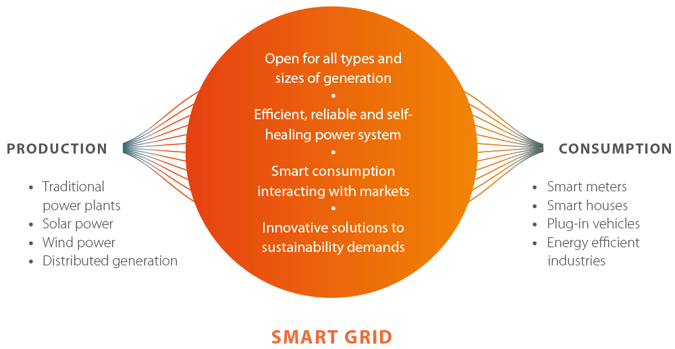
SGEM in a nutshell
ISGAN

Slide 3

Outline
ISGAN
Country/Economy Smart Grid Status
High priority technical needs for smart grid development and/or deployment
Potential Smart Grid test bed facilities
Capabilities of the facility
Research and technology focus areas of facility
Anticipated values and results
Notes:
Live work and safety in distribution networks
Alternatives to wooden poles
Improve communication of fault statistics
Increased automation in MV networks
Finalization of Smart Meter deployments
Pilots for micro grids, LVDC distribution, phase-earthing, smart living concepts

Slide 4






Finnish Smart Grids Evolution
ISGAN
Smart Grid 2.0
Phase 5
Next generation of management systems
Overall Drivers
Minimizing CO₂ emissions
Energy Efficiency
Grid Reliability
Activated role of small customers
2013
Phase 4
New ICT & Automation
New ways of planning grids
New Business Opportunities
2012
Phase 3
New Energy Markets on SG
Smart Customer Interfaces
Safe operation of SG
2011
Phase 2
New Grid Architecture
New Grid solutions
Demonstrations
2010
Phase 1
Change Drivers in Business
New active resources
Enabling technologies
2009
Smart Grid 1.0

Slide 5

Smart Grid Needs for Development
Interactive customer – an active resource
Vision
Efficient operation of energy system
Energy efficiency of end use
Market participation; loads, DG, storages
Easy and secure operation
Quality of supply; voltage, uninterrupted use of E
Research topics
Behaviour of interactive customer; 2012,2020,2035
needs, hopes, requirements
use of energy in 2020, 2035
classification of customers
classification of loads
use cases
Management of interactive customer gateways
‘power line’, home automation, user interface, ICT architecture and interfaces
optimal operation of energy system
Smart local control of loads, generation and storages
technology, methods and algorithms
Estimation of loads, generation and storages
Methods, algorithms and systems
Customer trust and privacy
Potential for demand response
- classification of customers
classification of loads
incentives and barriers for different market players
Data security
Legislation and standardisation
Business potential and models for different market players
value chain, new market roles
new services, new players
how to share the risks
Impacts of interactive customers and customer gateway for market players and energy system
Concept of interactive two-way customer gateway
‘power line’, home automation, user interface, ICT systems
technology, functions, I/O
requirements, concept, proof of concept, pilots

Slide 6
Smart Grid Evolution

Slide 7
Potential Smart Grid Test Bed Facilities
ISGAN
Capabilities of the facility
Research and technology focus areas of facility
Anticipated values and results

Slide 8
Fish Port District in Helsinki (Kalasatama)
ISGAN
Elements of a carbon neutral power system
Distributed renewable generation and market based demand response
eMobility
Energy efficient buildings and energy systems of the buildings adapting to the needs of the inhabitants
Fault tolerant power grids
  Self-healing concept by a high level of grid automation
  Island mode operation of the distribution grid and distributed energy storages
New end customer services
  New services for eMobility
  New market based energy services
  VPP concepts including solar, wind and demand response
  Energy storages
Planning
Concepting
Implementation
2010
2011
2012

Slide 9
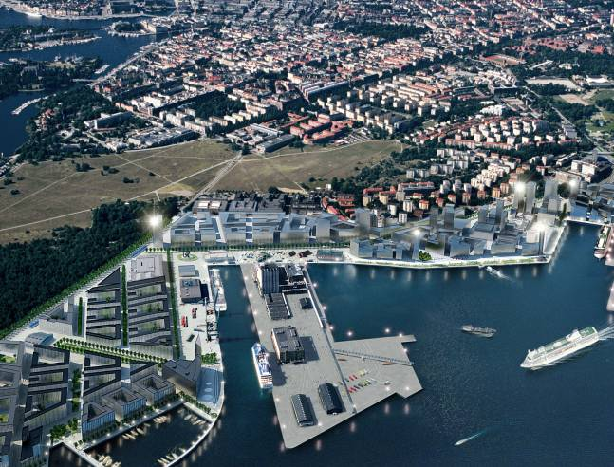
Real life demonstrations
Applications of next generation Smart Metering for energy management and end user services
M2M multi technology communication
Smart urban living
Applicability of telecom management for active resources
Using AMR data in management and customer communication
Intended islanding

Slide 10


Oleg Gulich
Research Manager, Smart Grids and Energy Market (SGEM) Program
Energy Solutions and Distribution, Fortum
Mobile: +358 40 1576452
E-mail: oleg.gulich@fortum.com
Questions?

