Slide 1
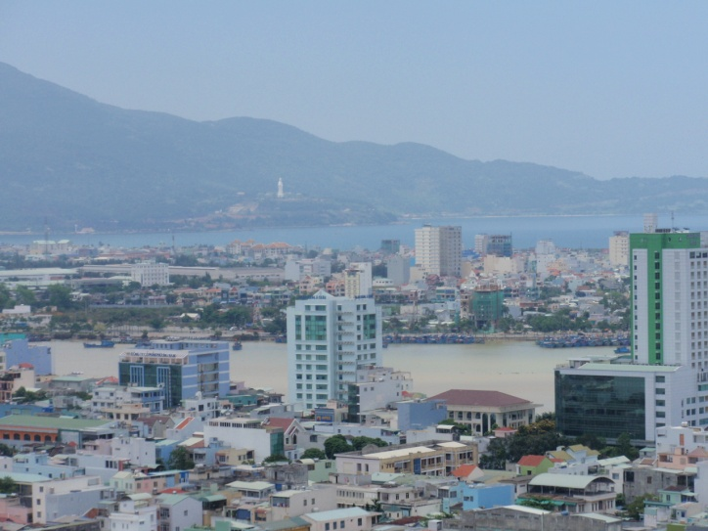
The implementation plan of the Low-carbon Model Town
Appendix 1
The candidate project
at Ngu Hanh Son District in Danang City, Vietnam
Notes:
1

Slide 2
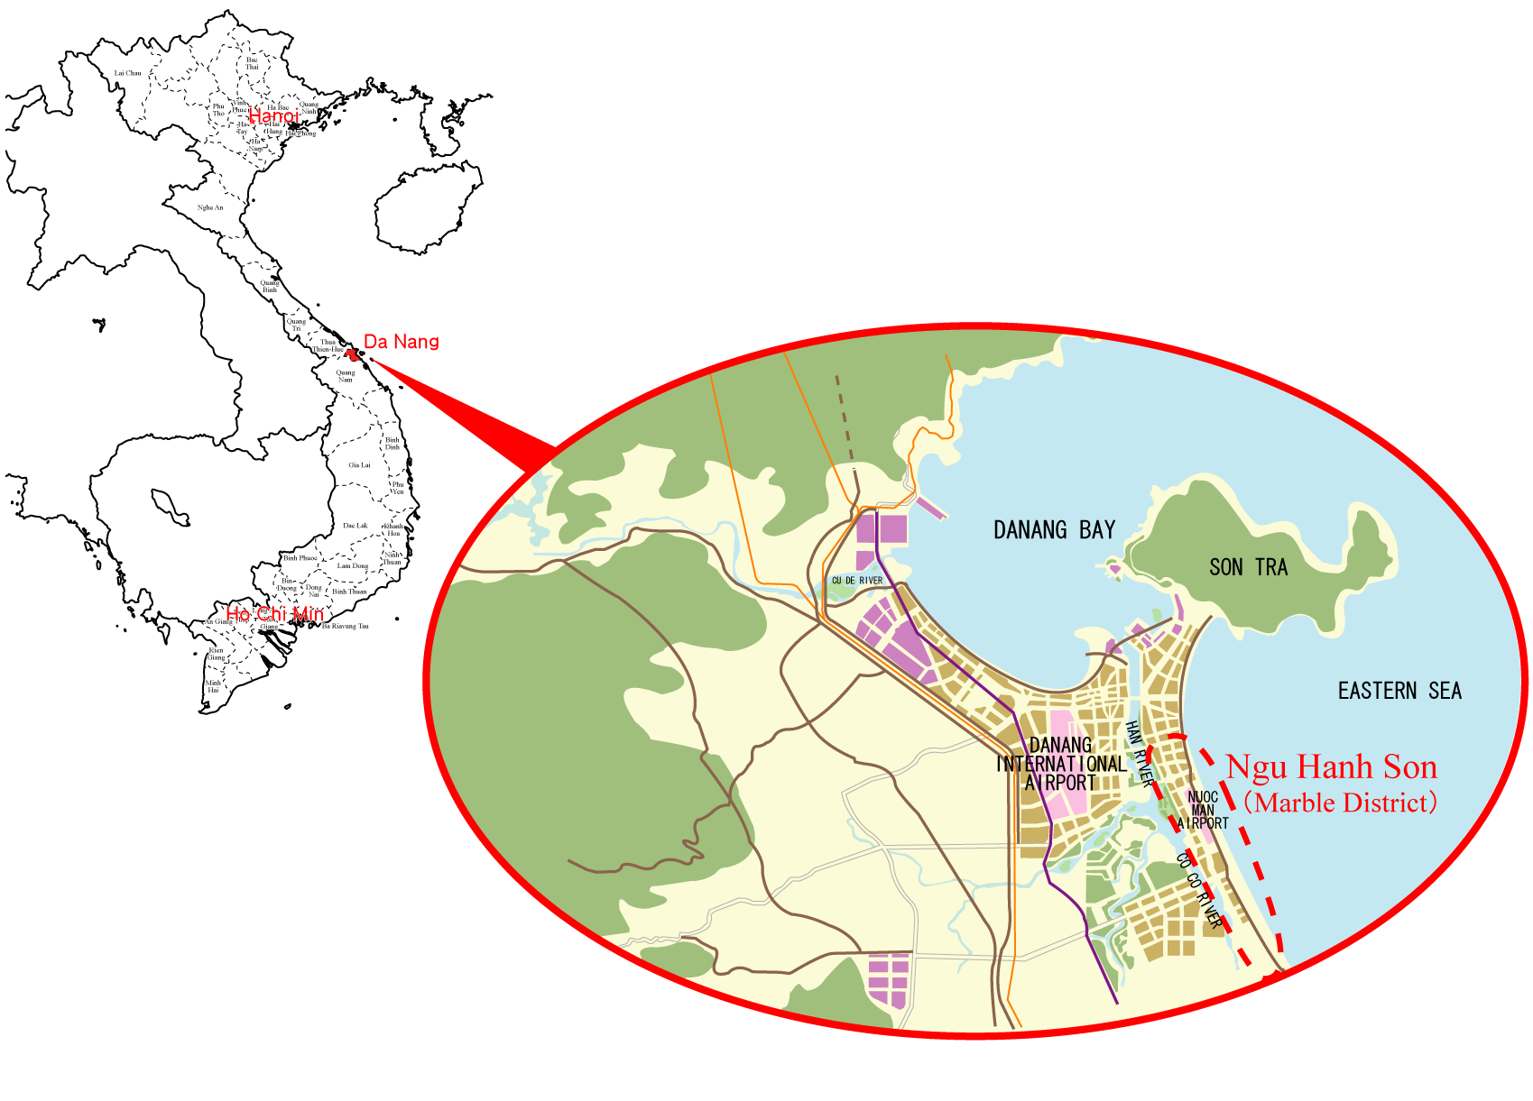
Location of Danang city and the candidate project
1
Notes:
2

Slide 3
The LCMT scheme for Ngu Hanh Son District, Danang City
Aiming at the cutting-edge model of LCT in the world by “applying a new technology” and “policy of an effective dissemination”
1. Methane recovery and effective utilization of biomass energy
1-1 Utilize methane generated from a sewage disposal and a kitchen waste for a fuel material of Bus Rapid Transit (BRT).
1-2 Utilize bio-diesel produced from seed oil of plant for a fuel material of BRT.
2. Low carbon-emission transportation system
2-1 Promote electric motorcycle : Establishing a restricted area for engine motorcycles in Ngu Hanh Son District, and building free plug-in stations.
2-2 Establish a low-carbon transportation system using BRT along trunk road which runs from the airport and urban area to Ngh Hanh Son District.
3. Introduction of technologies of energy saving and CO2 saving into buildings
3-1 Encourage employing the technologies into public facilities
- Air conditioning system with heat pump using river water or sea water,
- BEMS, HEMS and CEMS,
- Photovoltaic power plants,
- Eco-friendly landscape design
3-2 Promotion policy introducing the technologies into the facilities of private sector
- Comprehensive assessment system for built environment efficiency,
- Environment-consideration guideline for buildings.
4. Encouragement of dissemination of LCMT
- Visualization of eco-friendly actions for urban residents,
- Encouraging people’s participation to eco-friendly action.

Slide 4
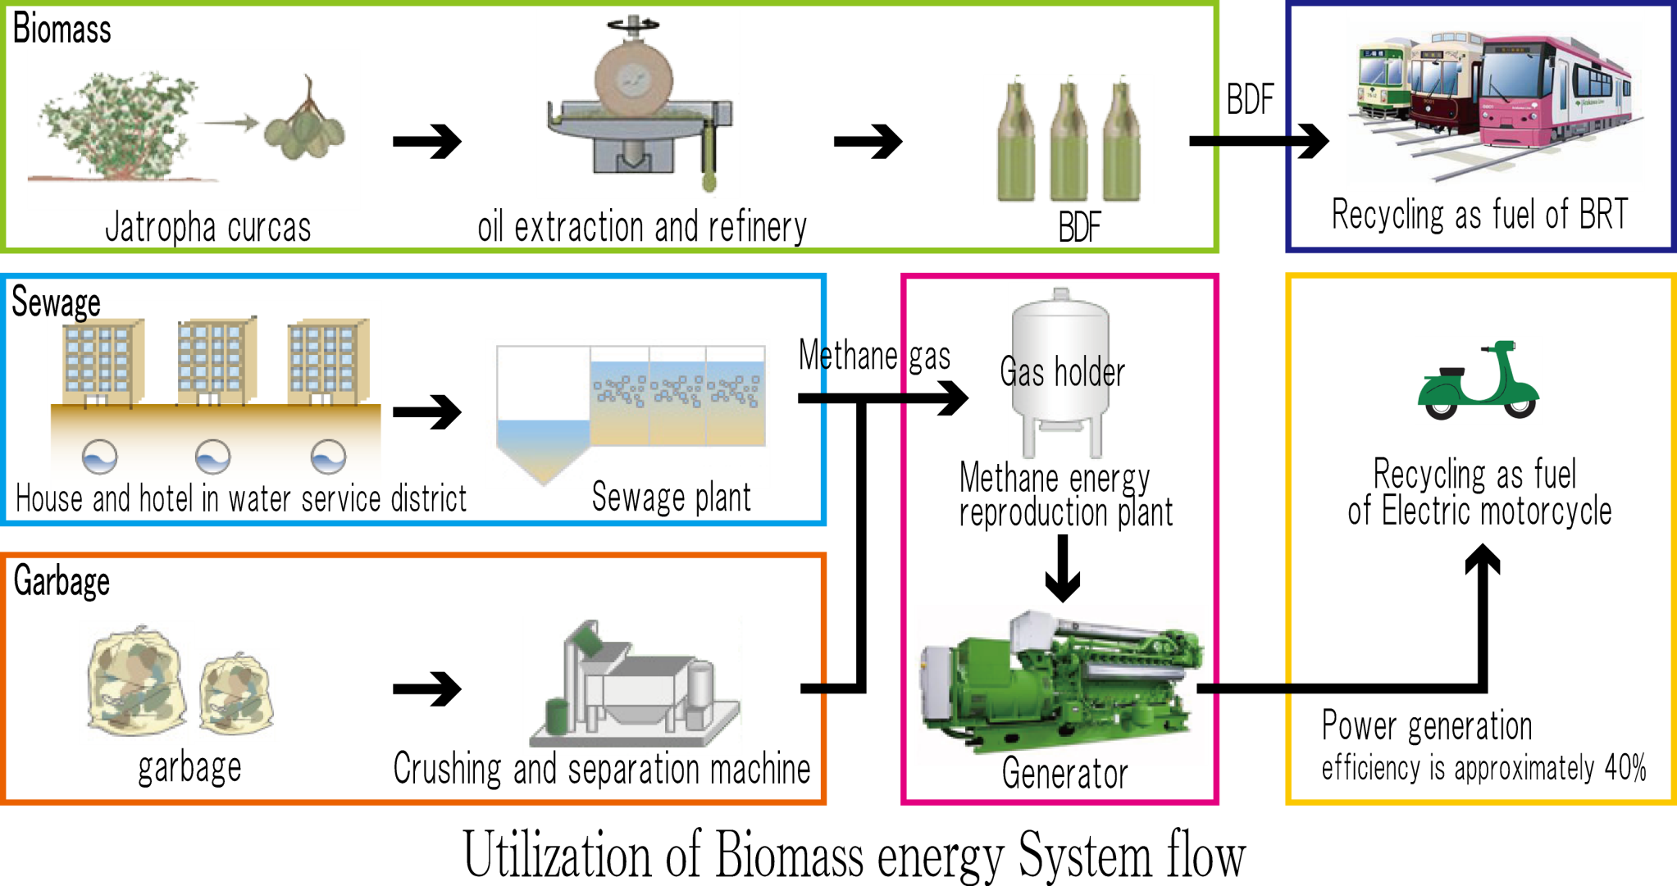
1. Methane recovery and effective utilization of biomass energy
1)Plant trees producing non-edible oil on degraded land possibly. Bio-diesel is produced from it.
2)The accumulation of methane that is generated from an existing sewage plant with an integrated garbage, is used for the fuel of BRT.
3) The accumulated methane gas is burn to generate electricity while is used for electric bike.
Effective use of biomass energy, alternative to low carbon emission transportation.
3
Notes:
4

Slide 5
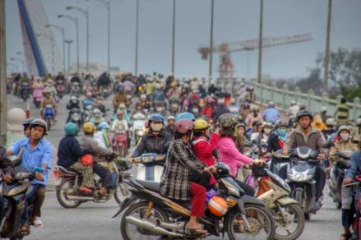
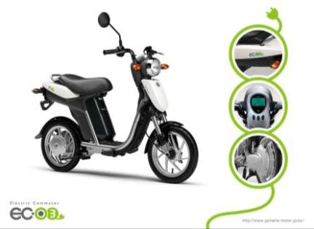
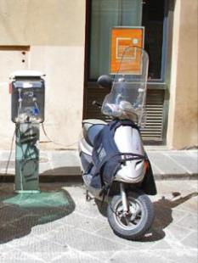
2-1. Promotion of electric motorcycles
1) In Da Nang, motorcycle currently accounts for 94% of all public transport shares. Both lowering carbon emissions for motorcycles and improving public transportation system (bus) are pressing issues.
2) We propose following measures in order to further encourage the on-going shift from existing motorcycles to electric motorcycles.
  a) Establishing a restricted area for engine motorcycles in Marble District (resort area) as an environment-friendly measure.
  b) Building free plug-in stations in motorcycle-parking areas in the city center and resort areas.
Electric motorcycle
Traffic conditions in the city of Da Nang
4
Notes:
5

Slide 6
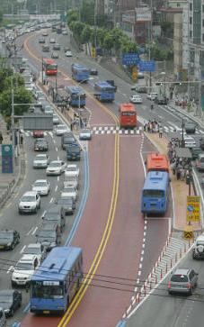
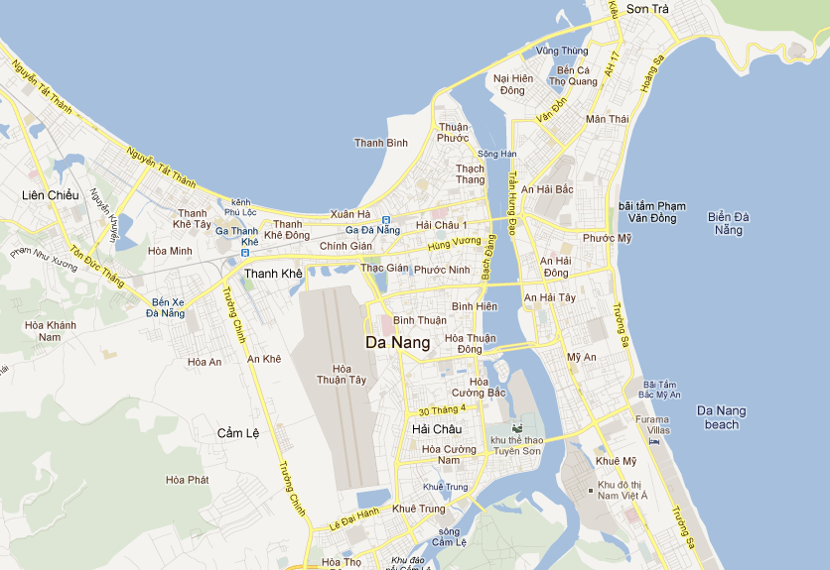
2-2．A low-carbon emission transportation system using BRT (Bus Rapid Transit)
1) Introducing a BRT system in resort areas in which low-emission buses run on its own right-of-way along the center of streets.
2) Restricting private vehicles and promoting the use of public transit by establishing a transit mall centering on BRT stations and by regulating cars and engine motorcycles in downtown.
BRT Route
BRT in Seoul, South Korea
5
Notes:
6

Slide 7
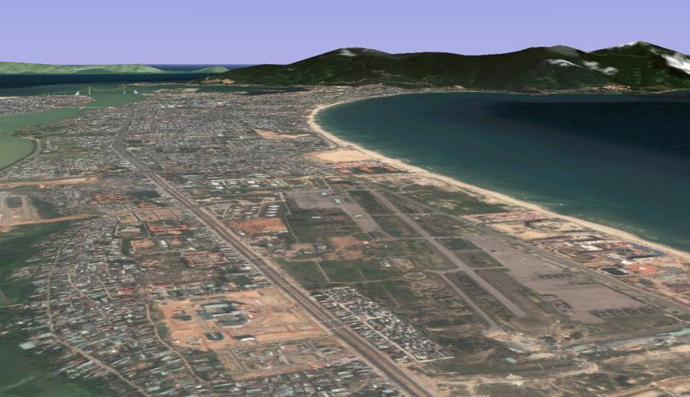
3-1. Encourage employing the technologies into public facilities
1) Heat pump systems with highly efficiency using water are installed at Marble district where is remarkably suitable for this systems because there are river and sea near this area.
2) Collective setting of heat supply facilities (Heating and cooling for districts)
Marble
Area
Han
River
Heat
pump
Eastern
Sea
Han River
Eastern Sea
Heat
pump
Heat Pump
Inlet
Outlet
Collective setting of heat supply facilities
Collective setting area of heat supply facilities
Office
Hotel
School/
Hospital
Residence
HT
CT
TR
HP
Cool Water Tank
Cool and Hot Water Tank
Hot Water Tank
High effective heat pump
systems using river water
Plant
HP: Heat Pump, TR: Turbo Freezer
CT: Cooling Tower, HT: Heating Tower
6

Slide 8
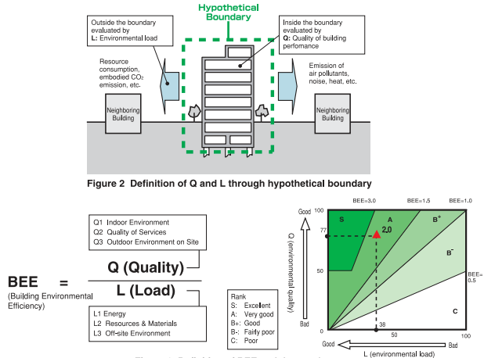
3-2. Promotion policy introducing the technologies into the facilities of private sector
Charge the resort facilities in Ngu Hanh Son District where development investment has been extending in a large scale with the evaluation of environment function like CASBEE (Comprehensive Assessment System for Building Environment Efficiency) .
Provide an incentive for the developers to approach the CO2 saving by opening the result of environment function evaluation at each facility.
Open the application know-how of CASBEE in Ngu Hanh Son District to the public, subsequently disseminate CASBEE to the whole Vietnam.
Build the CASBEE of Vietnam by Danang City and Danang University in collaboration with Japanese technical experts.
7
Notes:
8

Slide 9
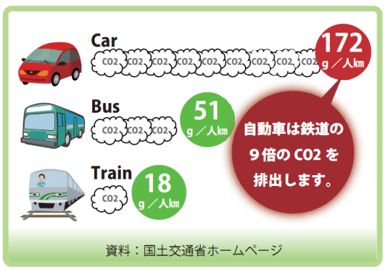
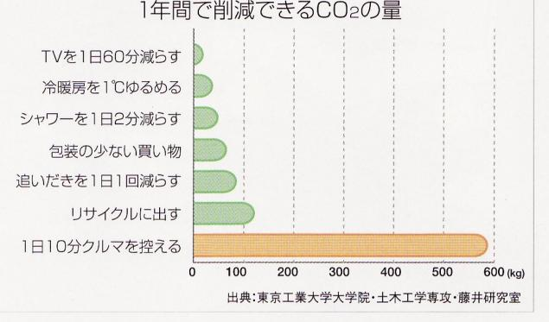
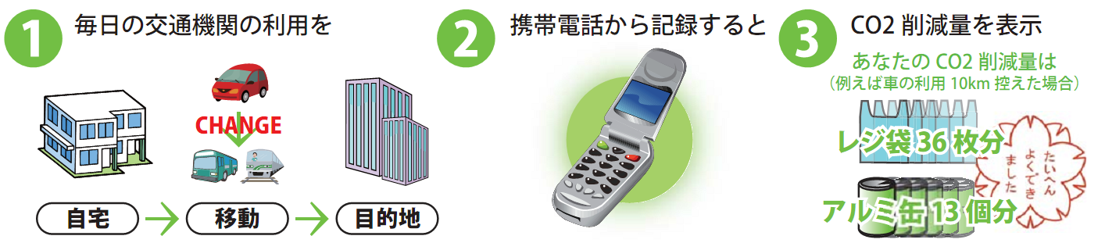
4. Visualization and people's participation
1) Explaining the effects of low-carbon emissions by this project to city residents on websites and in the brochures, and encouraging their cooperation to the project.
2) Appealing for cooperation to the project and shift to eco-friendly lifestyles by distributing information about eco-friendly lifestyles and CO2 reduction effects by office activities to city residents.
Annual CO2 reduction amount
Watch TV 60 min. /day less
g/person km
Set 1 °C lower for AC
Automobiles emit CO2 9 times more than railways
Shorten shower time by 2 min. /day
g/person km
Less wrapping on shopping
Avoid re-preparing twice in a day
Maximize recycle efforts
g/person km
Drive a car fro 10 min less
Resource: The Ministry of Land, Infrastructure, Transport and Tourism
Resource: Tokyo Institute of Technology, Graduate School of Engineering, Department of Civil Engineering, Fujii Lab
Daily transportation use
Record it on cell phone
Display CO2 reduction amount
Your CO2 reduction amount
(Reducing the use of car by 10km)
36 shopping bags
Home
Travel
Destination
13 aluminum cans
8
Notes:
9

Slide 10
5. Estimation of Reduction of CO2 emission
Tech. No. | Methods |  |  | t-CO2/yr
1 | Sewage/sludge | Methane generation emission 2,116.1m3/day | Greenhouse factor is 21 | (18,571,070)
2-1 | Electric motorcycle etc. | 80% of engine motorbike is replaced |  | 152,338
2-2 | BRT in the city |  |  | 22,532
3 | Energy management at hotels | for 10 years 20% energy saving |  | 49,292
Sum |  |  |  | 224,162 (18,795,232)
This proposal is expected to reduce CO2 emissions by 9.5% compared to 2008.
9

